Slide 1
Survey on Machine Learning and Code Smells
Rodger Byrd
UCCS
CS6000

Slide 2
Introduction
Link to Youtube presentation
https://youtu.be/byzLm7-g840

Slide 3
Background
A lot of Research has been done on code smells
Many previous survey papers
A Survey on software smells
A systematic literature review: Refactoring for disclosing code smells in object oriented software
Smells in software test code: A survey of knowledge in industry and academia[
Using Machine Learning to detect and correct code smells is a rapidly growing field

Slide 4
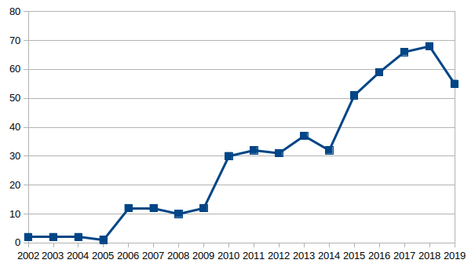
History of Research

Slide 5
Definitions
Machine Learning
Machine learning is defined as computers learning to solve problems without being explicitly programmed, although they are “trained”
Arthur Samuel coined the term Machine Learning in 1959
Machine learning is a subset of artificial intelligence. It uses algorithms and statistical models to execute a task without explicitly being programmed.
Machine learning is used in a wide variety of applications such as email spam filtering, search engines, video surveillance, and image curation.

Slide 6
Definitions-continued
Anti-Patterns
The term antipattern was coined by Andrew Koenig
It is defined as a commonly reinvented bad solution to a problem.
Some common examples of antipatterns are as follows
Singleton Overuse: Overuse of singletons as they violate information hiding
Spaghetti: very long methods and classes with many lines of code.
Blob: a class with lots of attributes and methods, which can be unrelated.

Slide 7
Definitions-continued
Code Smells
Kent Beck coined the term “code smell”
certain structures in the code that suggest (sometimes they scream for) the possibility of refactoring
Some common examples of code-smells are as follows
Object-Oriented Abusers: misuse of object-oriented programming principles
Change Preventers: where multiple places in code need to be updated for a single change made somewhere else.
Dispensables: pointless or useless code

Slide 8
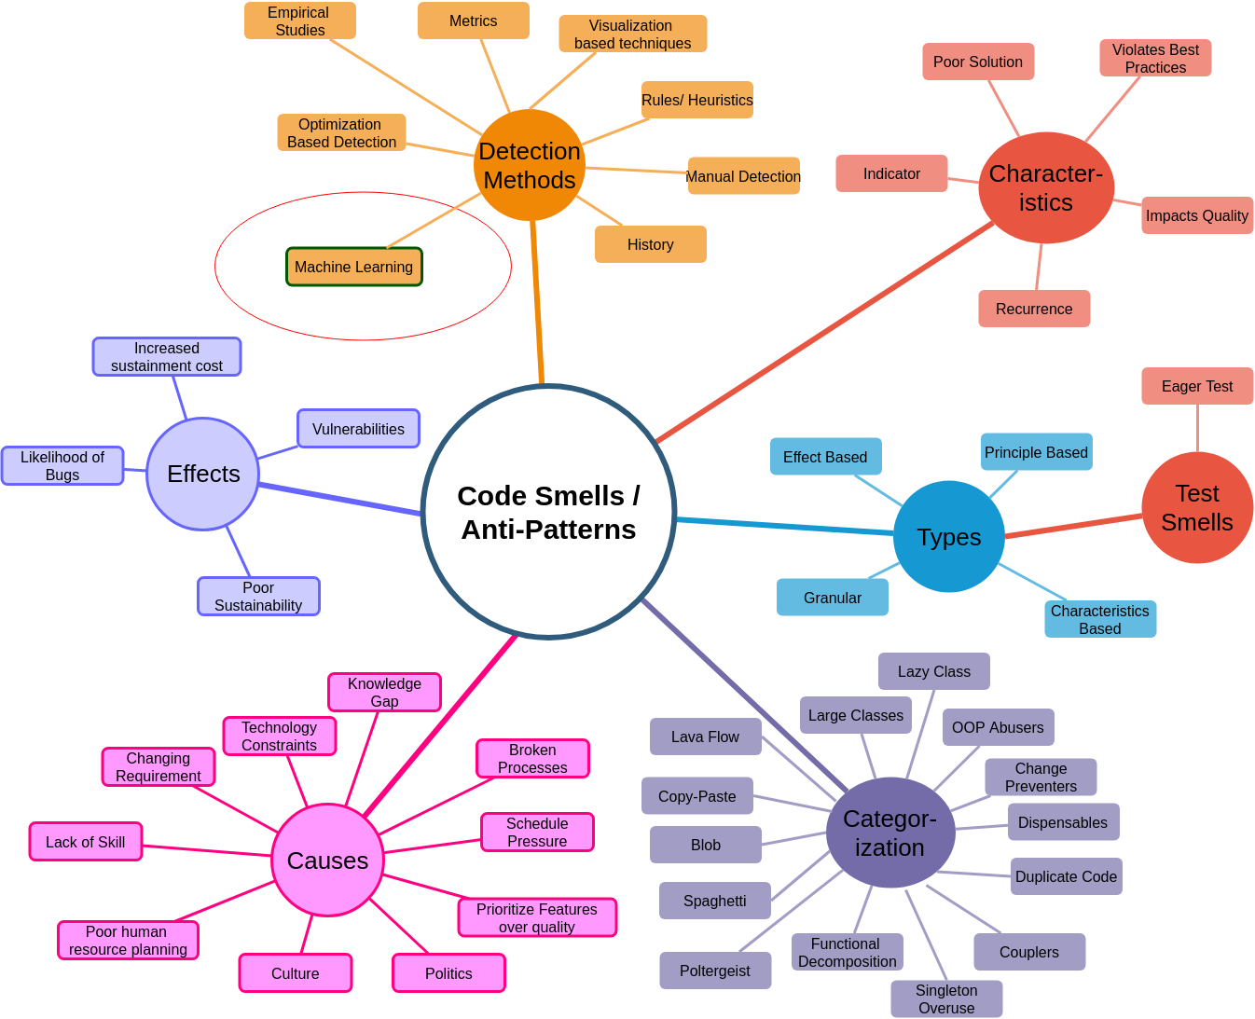
Results – Topic Maps

Slide 9
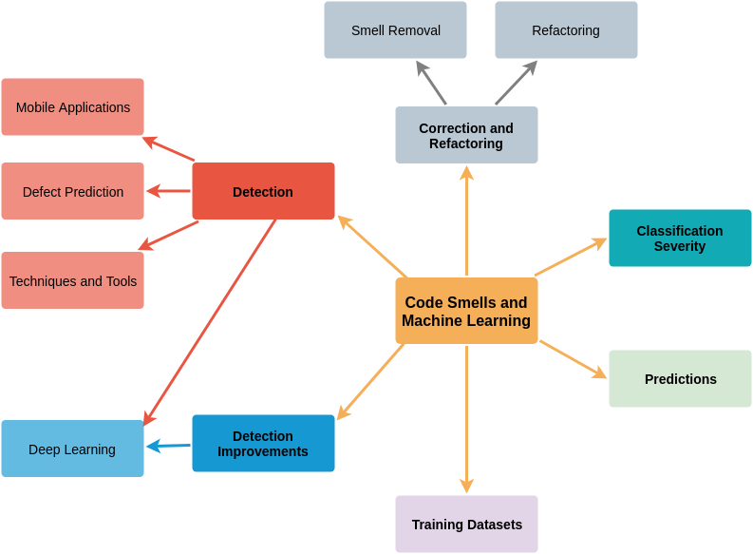
Results – Topic Maps

Slide 10
Machine Learning Code Smell Detection Performance
Showed greater than 96% accuracy and only required 100 training examples to get above 95%
One of the largest studies used
16 different ML algorithms
4 code smells
Used 1986 manually validated code smell samples for the training dataset
Top 2 algorithms (large Effect Size)
B-J48 Pruned
Random Forest
Following 8 algorithms (in order of Performance)
B-JRip, B-J48 Unpruned, B-Random Forest, J48 Pruned, J48 Unpruned, Jrip, B-J48 Reduced Error Pruning, J48 Reduced Error Pruning

Slide 11
Machine Learning Code Smell Detection Performance
Performance Differences with different training datasets
Wide variability of performance results in papers surveyed
Multiple approaches to Training Datasets
Manually created datasets
Automatically created by looking at codebase changes over time

Slide 12
Machine Learning Code Smell Detection Performance
Comparison against Heuristic Methods
Heuristic Methods use detection rules based on software metrics
Comparing against the Naïve Bayesian ML algorithm the ML algorithm had the same level of performance

Slide 13
Machine Learning Code Smell Detection Survey Topics
Vulnerability Detection
Mobile Applications
Techniques and Tools
Deep Learning- Neural Networks
Detection on Web Services
Code Smell Detection Improvements
Code Smell Correction and Refactoring
Code Smell Predictions

Slide 14
Discussion
Challenges
Identifying Code Smells
Creating training datasets
Inconsistent Taxonomies for code smells and antipatterns
Can’t inform best practices for developers
Code smells and antipatterns cause confusion to a developer reading code
Developers spend more time reading than writing code
Correcting code smells would lead to more sustainable stable code at lower cost

Slide 15
Conclusion
Flexibility in ability to write code results in many different implementations for the same results
Poor Implementations introduce risk and result in less stable code with a higher cost to maintain
Examples include A person in Temp Az hit by a self driving car and the 737 MAX code developers.
Results of using ML to detect and correct code smells varies
Training Datasets
Different Algorithms
Software Sustainment and assurance is one of the most expensive parts of the software life cycle and using ML to detect code smells could have a major impact on that

Slide 16
References
For citations to presentation, see the attached paper

